Slide 1

FINAL PROJECT
CLOUD TECHNOLOGY FOR BUSINESS ANALYTICS

Slide 2
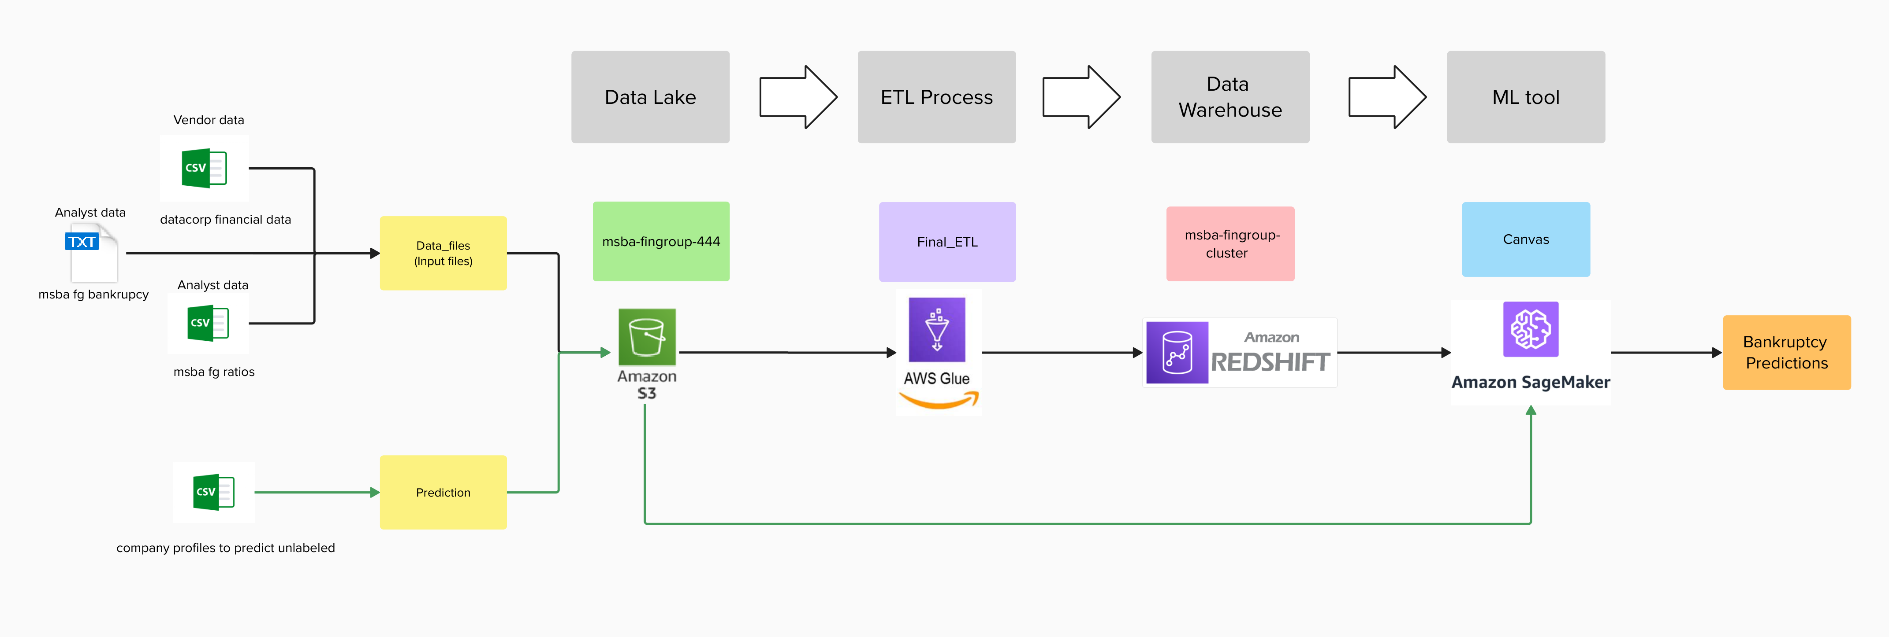
DATA ARCHITECHTURE

Slide 3
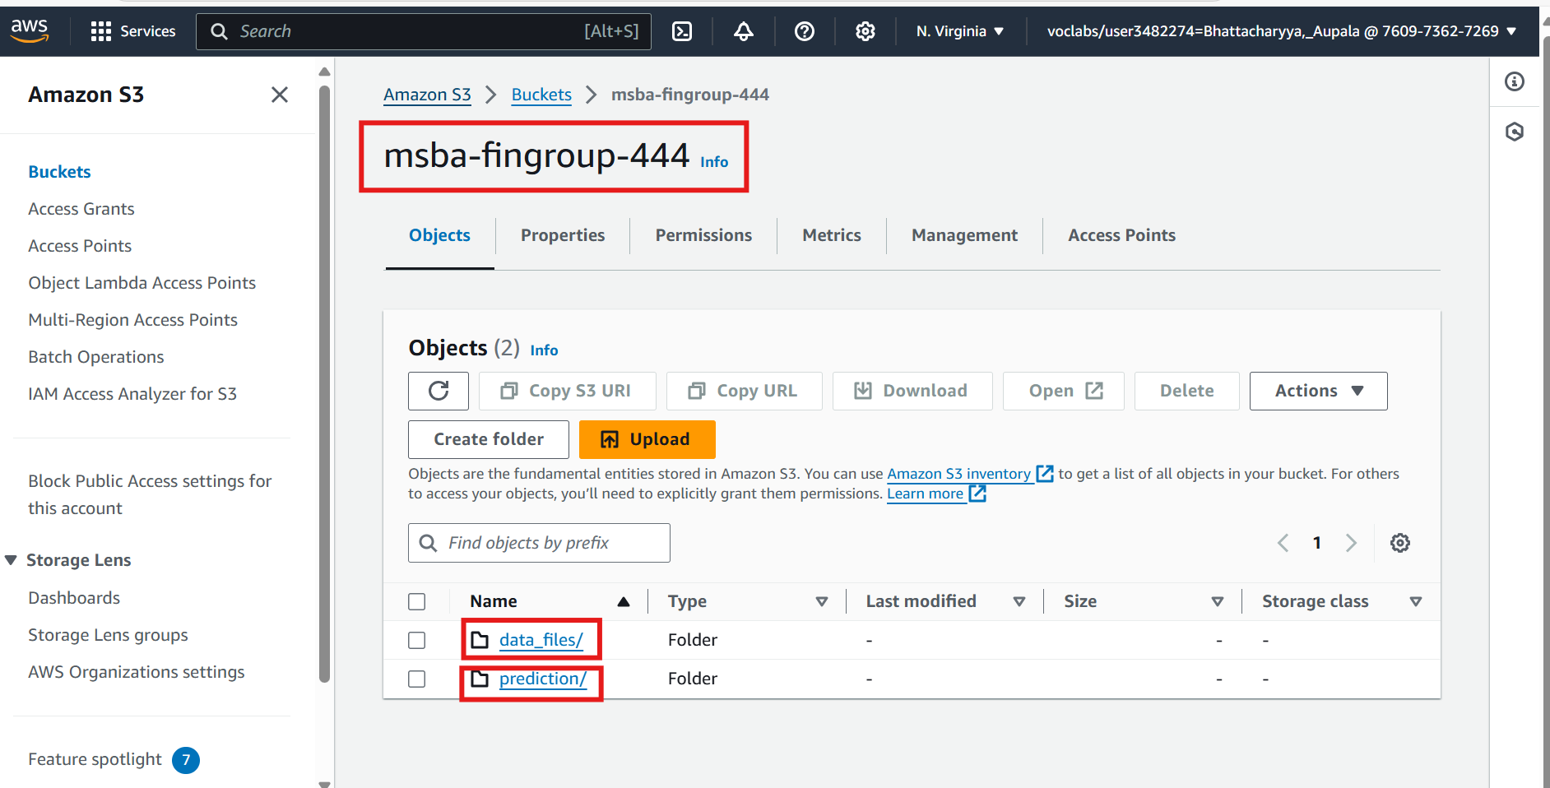
DATA LAKE

Slide 4
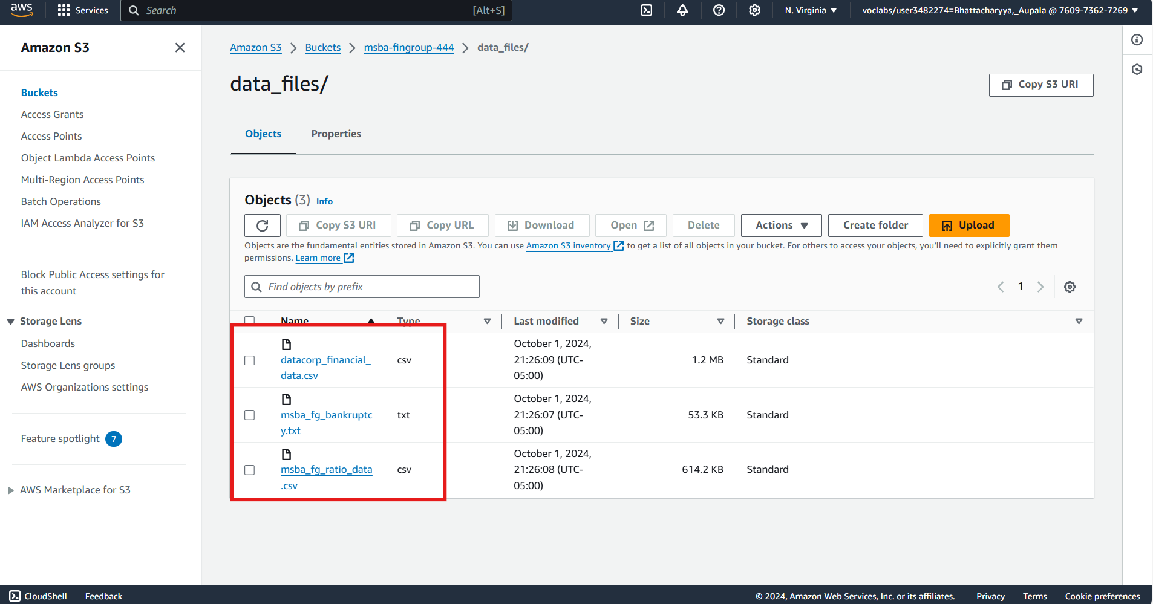

Slide 5
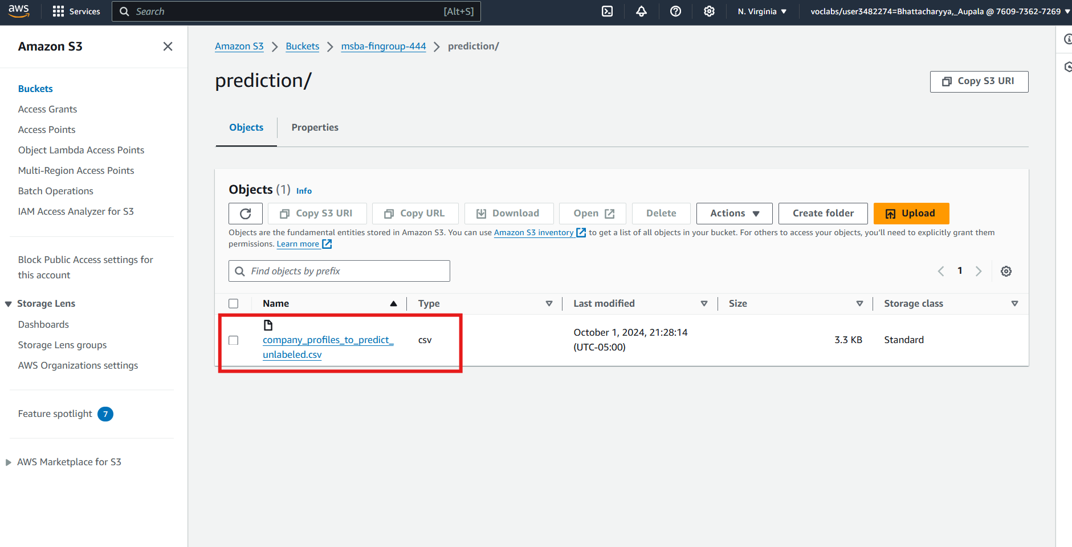

Slide 6
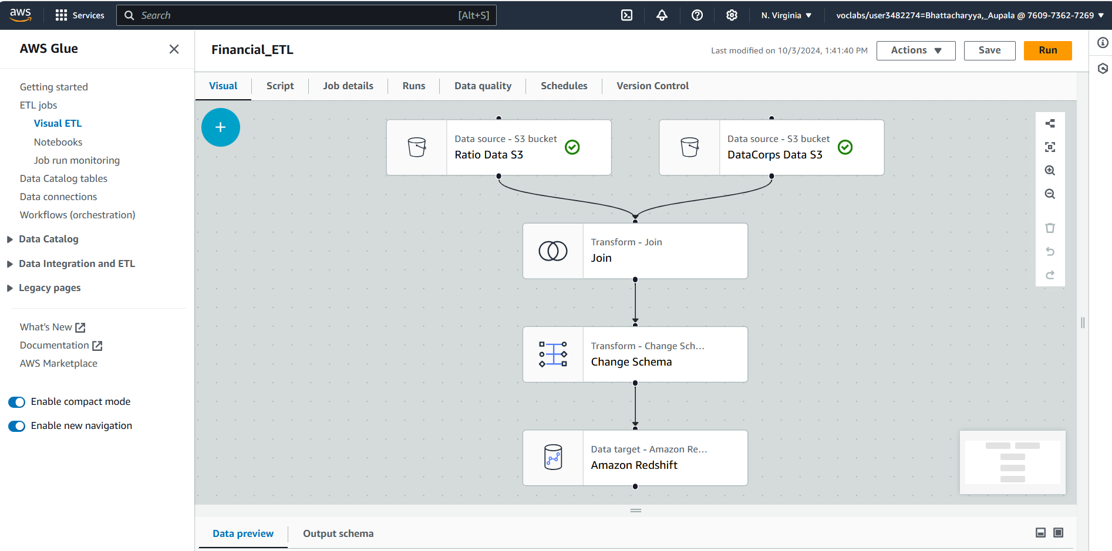
ETL PROCESS

Slide 7
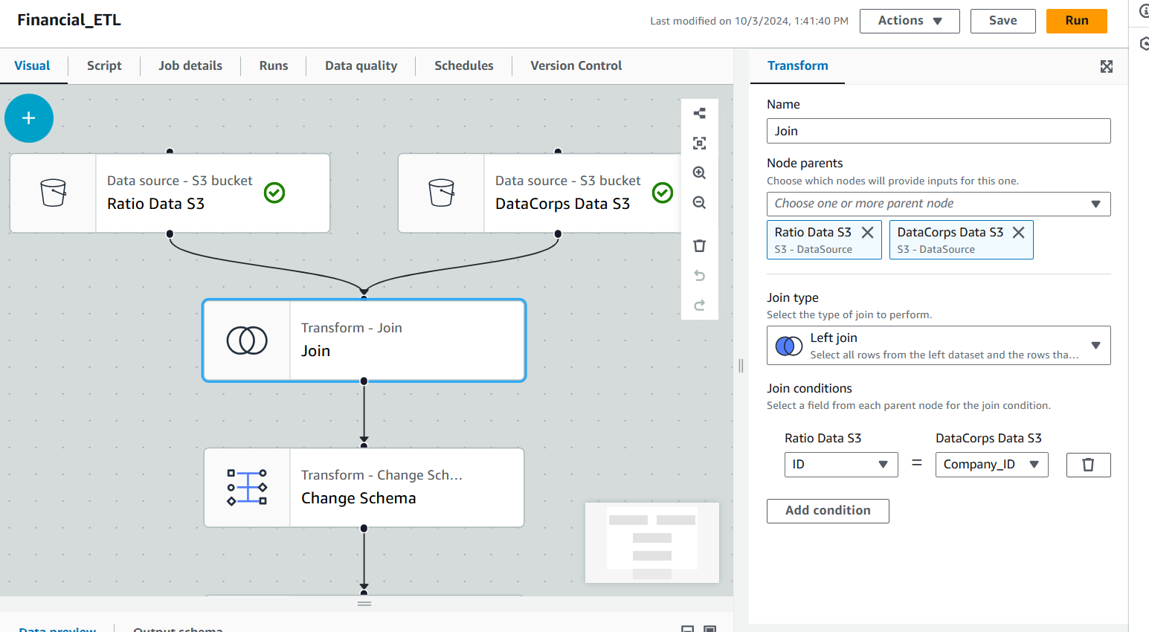
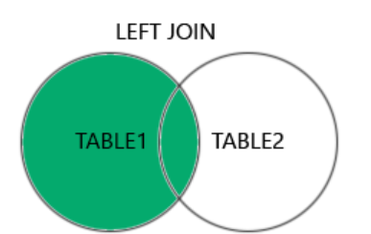
LEFT JOIN USING COMPANY ID’s

Slide 8
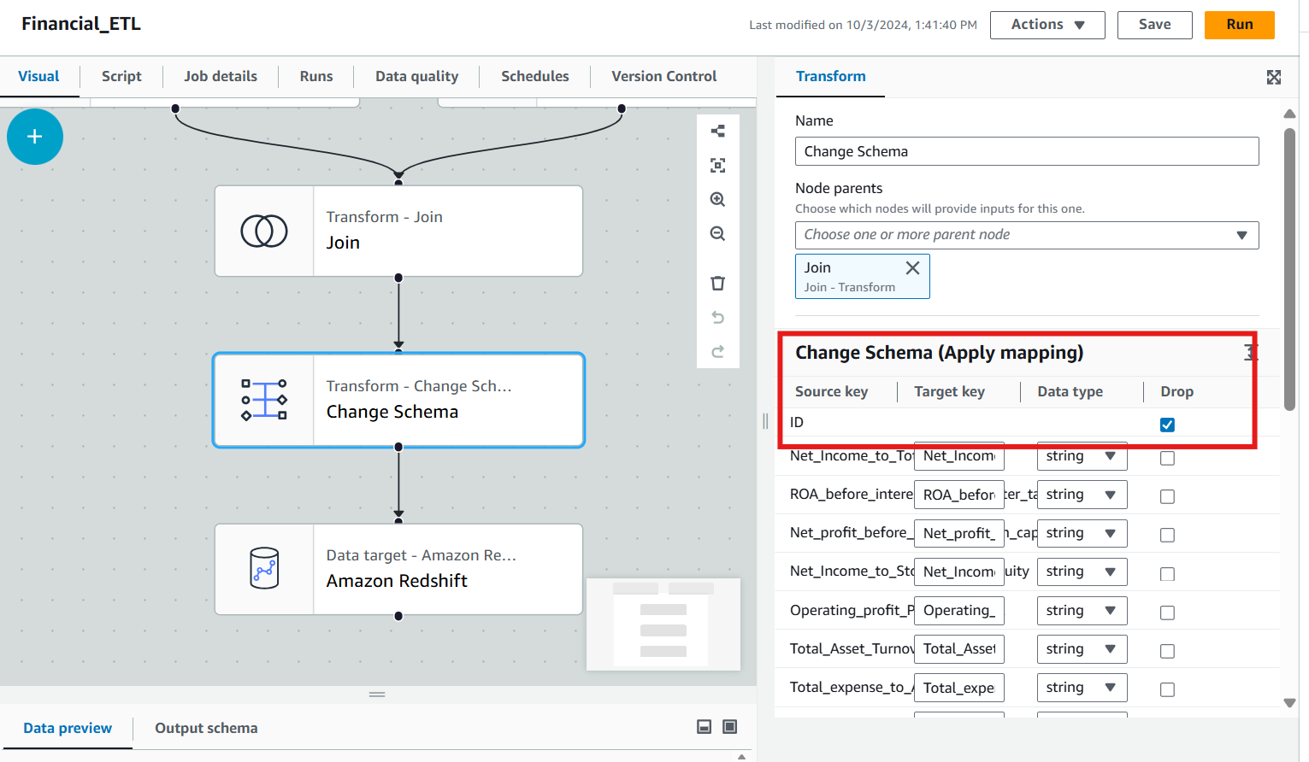
REMOVE REDUNTANT COLUMNS

Slide 9
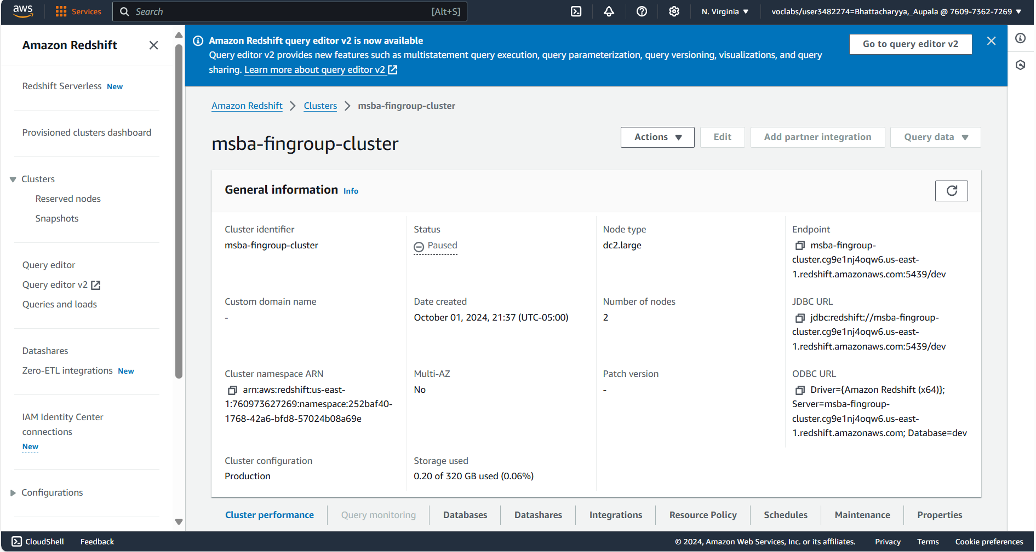
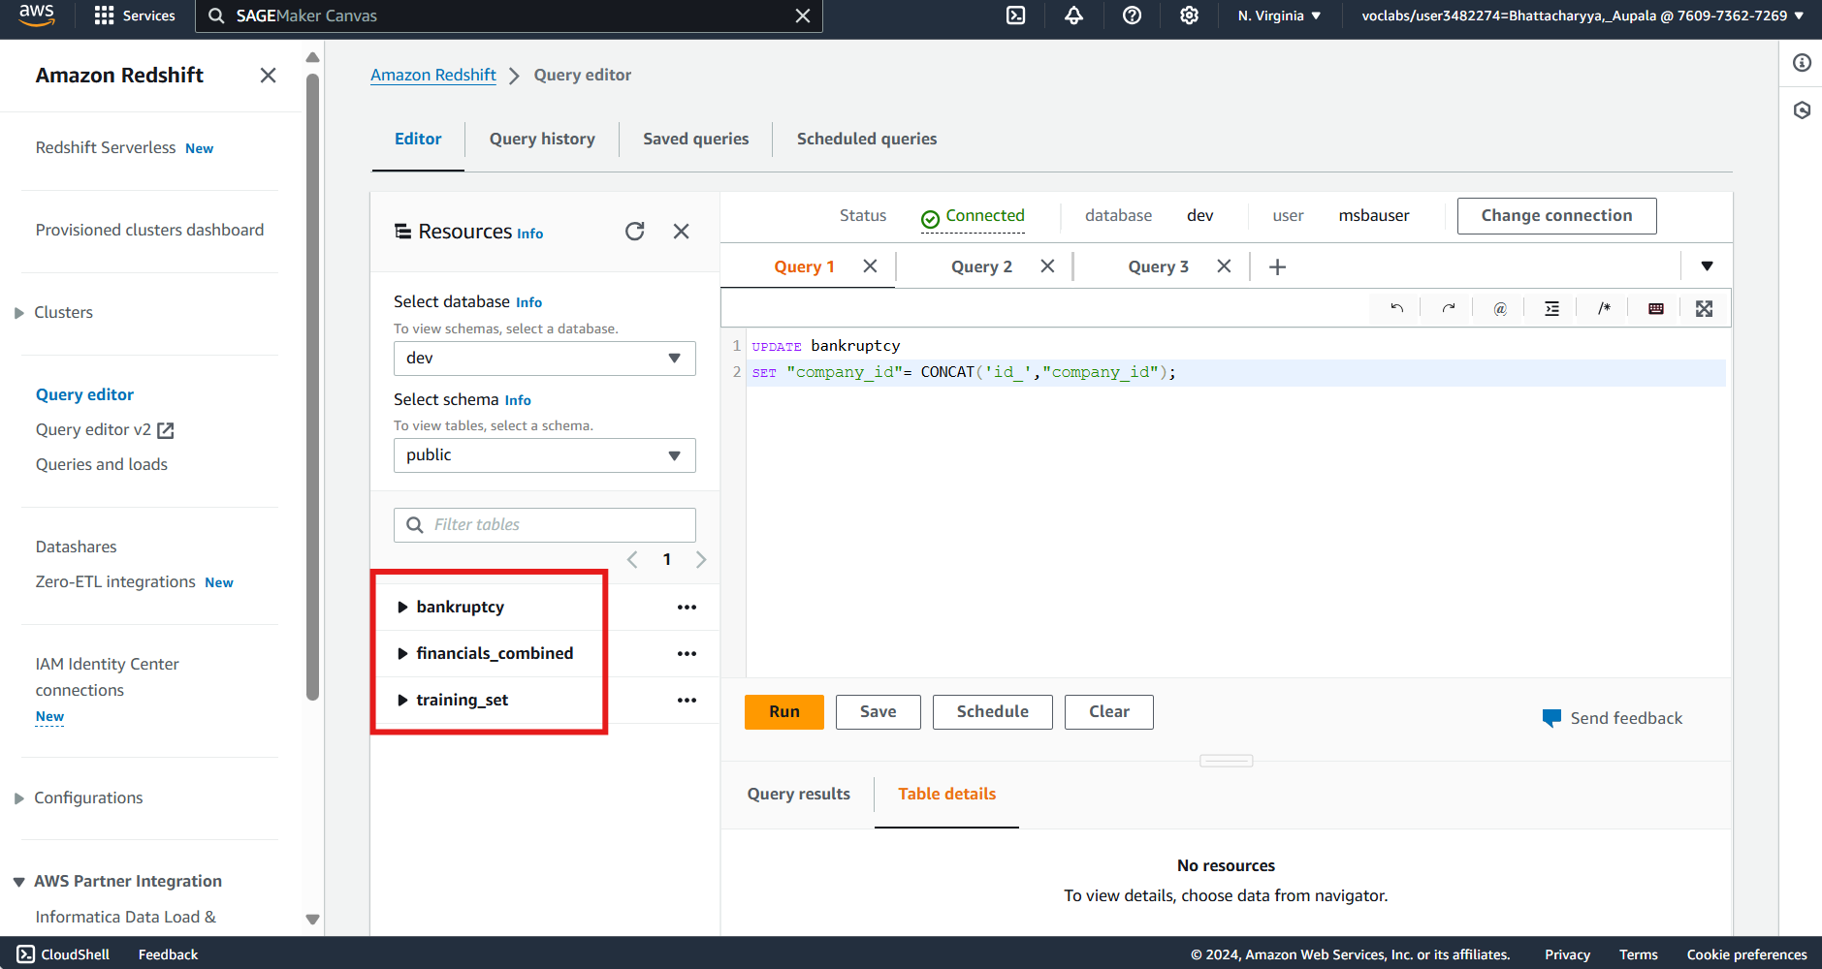
DATA WAREHOUSE

Slide 10
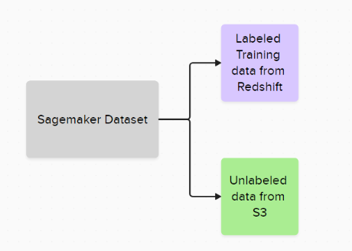
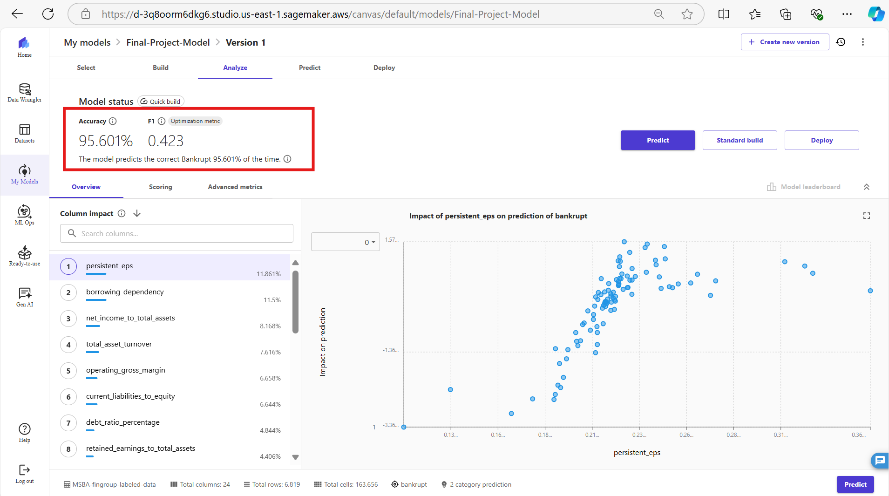
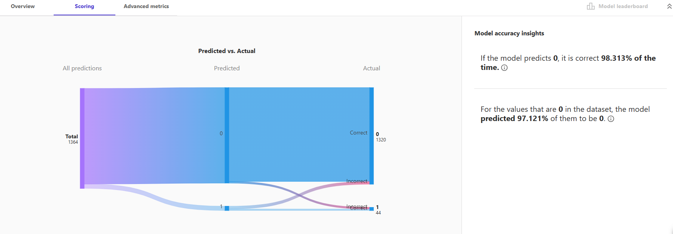
MACHINE LEARNING MODEL

Slide 11
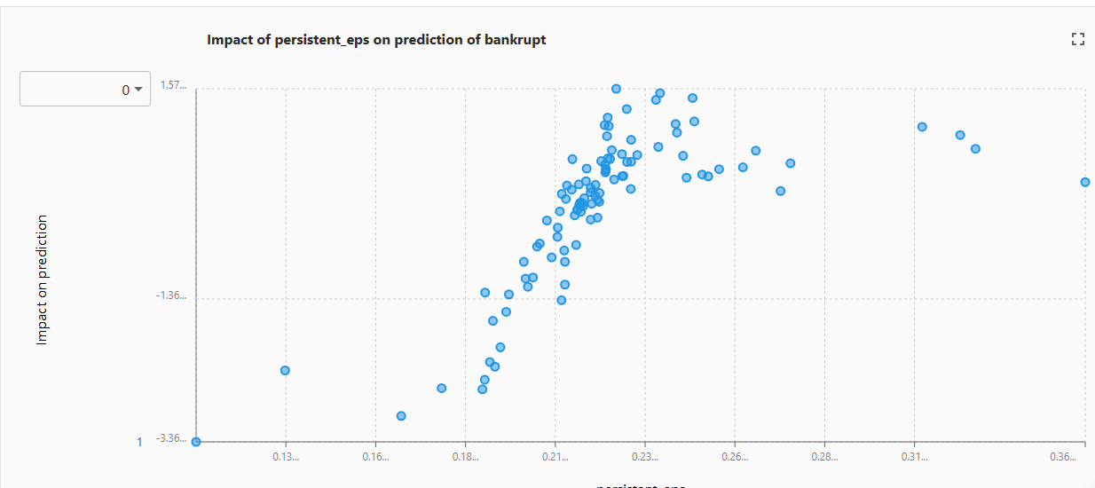
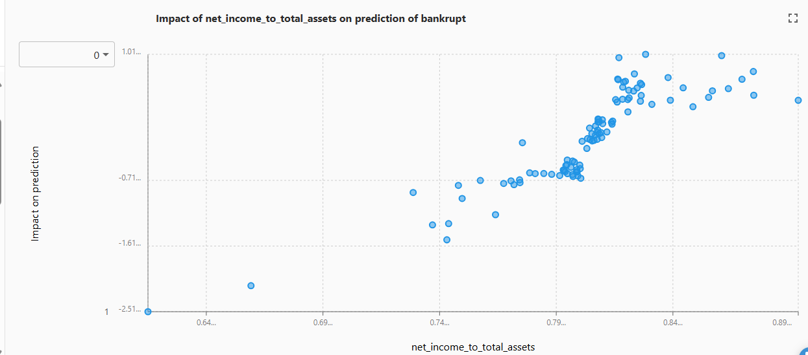
EDA

Slide 12
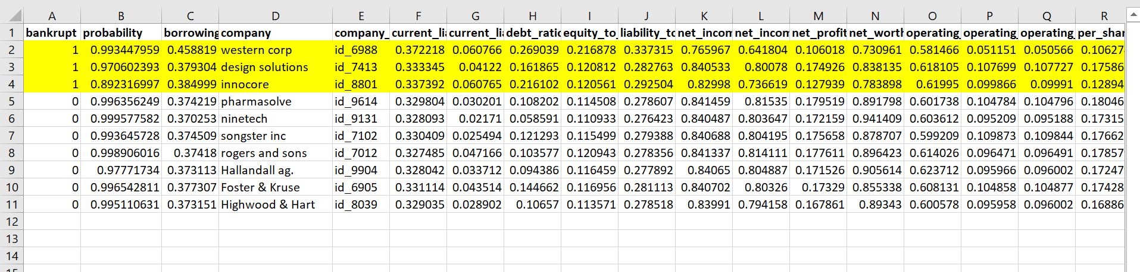
OUTPUT
PREDICTIONS:
Not Bankrupt
Pharmasolve
Ninetech
Songster inc
Rogers and sons
Hallandall ag.
Foster & Kruse
Highwood & Hart
Bankrupt
Western Corp
Design Solutions
Innocore

Slide 13
RECOMMENDATIONS
Strong candidates for portfolio inclusion are Pharmasolve, Ninetech, Songster inc, Rogers & Sons, Hallandall ag., Foster & Kruse, and Highwood & Hart in the portfolio due to their stable financial health.
We may exclude Western Corp, Design Solutions and Innocore due to their high bankruptcy risk.
The ETL Process could be automated further by setting up weekly recurring runs.
EDA shows as persistent EPS & net income to total assets increases, the predicted impact on bankruptcy becomes more positive (reducing the risk of bankruptcy).
MSBA Financial group now has a streamlined and scalable system for further data predictions.

Slide 14
THANK YOU!

